Slide 1

OSPF area 0
R3 SID=3
Gi 0/0/1
192.168.3.11/24
Gi 0/0/2
192.168.10.11/24
OSPF area 1
Gi 0/0/3
192.168.3.10/24
Gi 0/0/3
192.168.10.10/24
R1 SID=1
R2 SID=2
R4 SID=4
R6 SID=7
Gi 0/0/4
192.168.4.10/24
Gi 0/0/4
192.168.11.10/24
Gi 0/0/1
192.168.1.10/24
Gi 0/0/1
192.168.1.11/24
Gi 0/0/1
192.168.4.11/24
Gi 0/0/2
192.168.11.11/24
Gi 0/0/1
192.168.100.10/24
Gi 0/0/5
192.168.5.10/24
Gi 0/0/5
192.168.12.10/24
Gi 0/0/1
192.168.5.11/24
Gi 0/0/2
192.168.12.11/24
R5 SID=5
Globa SRGB 16000~ xxxxx

Slide 2
OSPF area 0
Prefix-SID=300
R3
Gi 0/0/0
192.168.3.11/24
Gi 0/0/1
192.168.10.11/24
Adj-id 24002
Adj-id 24000
OSPF area 1
Segment list<16300,16510>
Tunnel 1
Gi 0/0/1
192.168.3.10/24
Gi 0/0/1
192.168.10.10/24
Prefix-SID=100
Prefix-SID=200
Prefix-SID=500
R1
R2
Adj-id 24002
Adj-id 24002
R5
Gi 0/0/0
192.168.1.10/24
Gi 0/0/0
192.168.1.11/24
Gi 0/0/0
192.168.100.10/24
Gi 0/0/2
192.168.4.10/24
Gi 0/0/2
192.168.12.10/24
Adj-id 24000
Adj-id 24004
prefix-SID 16510
Adj-id 24000
Adj-id 24000
Tunnel 2
Segment list<16400,16510>
Gi 0/0/0
192.168.4.11/24
Prefix-SID=400
Gi 0/0/1
192.168.12.11/24
R4
Adj-id 24000
Adj-id 24002
Globa SRGB 16000~ 23999

Slide 3

Host a
R2_fedora
[ens34]
2000:200a::100a/120
[ens35]
2000:2001::1002/120
[ens34]
2000:2002::1002/120
net15
net18
net17
[ens36]
2000:200a::1001/120
[ens35]
2000:2002::1004/120
R4_fedora
[ens34]
2000:2001::1001/120
R1_fedora
[ens36]
2000:200b::1004/120
net14
[ens34]
2000:200b::100b/120
Host b
IPv4 VPN tunnel over SRv6

Slide 4
Host a
R2_fedora
[ens34]
30.30.30.1/24
[ens35]
2000:2001::1002/120
[ens34]
2000:2002::1002/120
net15
net18
net17
[ens36]
30.30.30.2/24
[ens35]
2000:2002::1004/120
[ens34]
2000:2001::1001/120
R4_fedora
[ens36]
20.20.20.2/24
R1_fedora
[ens35]
2000:2003::1001/120
[ens34]
2000:2004::1004/120
net19
net16
net14
R3_fedora
[ens35]
2000:2003::1003/120
[ens34]
20.20.20.1/24
[ens34]
2000:2004::1003/120
Host b
IPv4 VPN tunnel over SRv6

Slide 5
Host a
R2_fedora
[ens34]
30.30.30.1/24
[ens35]
2000:2001::1002/120
[ens34]
2000:2002::1002/120
net15
net18
net17
[ens36]
30.30.30.2/24
[ens35]
2000:2002::1004/120
[ens34]
2000:2001::1001/120
R4_fedora
[ens36]
20.20.20.2/24
R1_fedora
[ens35]
2000:2003::1001/120
[ens34]
2000:2004::1004/120
net19
net16
net14
R3_fedora
[ens35]
2000:2003::1003/120
[ens34]
20.20.20.1/24
[ens34]
2000:2004::1003/120
Host b
IPv4 VPN tunnel over SRv6

Slide 6
Host a
R2_fedora
[ens34]
2000:200a::100a/120
[ens35]
2000:2001::1002/120
[ens34]
2000:2002::1002/120
net15
net18
net17
[ens36]
2000:200a::1001/120
[ens35]
2000:2002::1004/120
[ens34]
2000:2001::1001/120
R4_fedora
[ens36]
2000:200b::1004/120
R1_fedora
[ens35]
2000:2003::1001/120
[ens34]
2000:2004::1004/120
net19
net16
net14
R3_fedora
[ens34]
2000:200b::100b/120
[ens35]
2000:2003::1003/120
[ens34]
2000:2004::1003/120
Host b

Slide 7
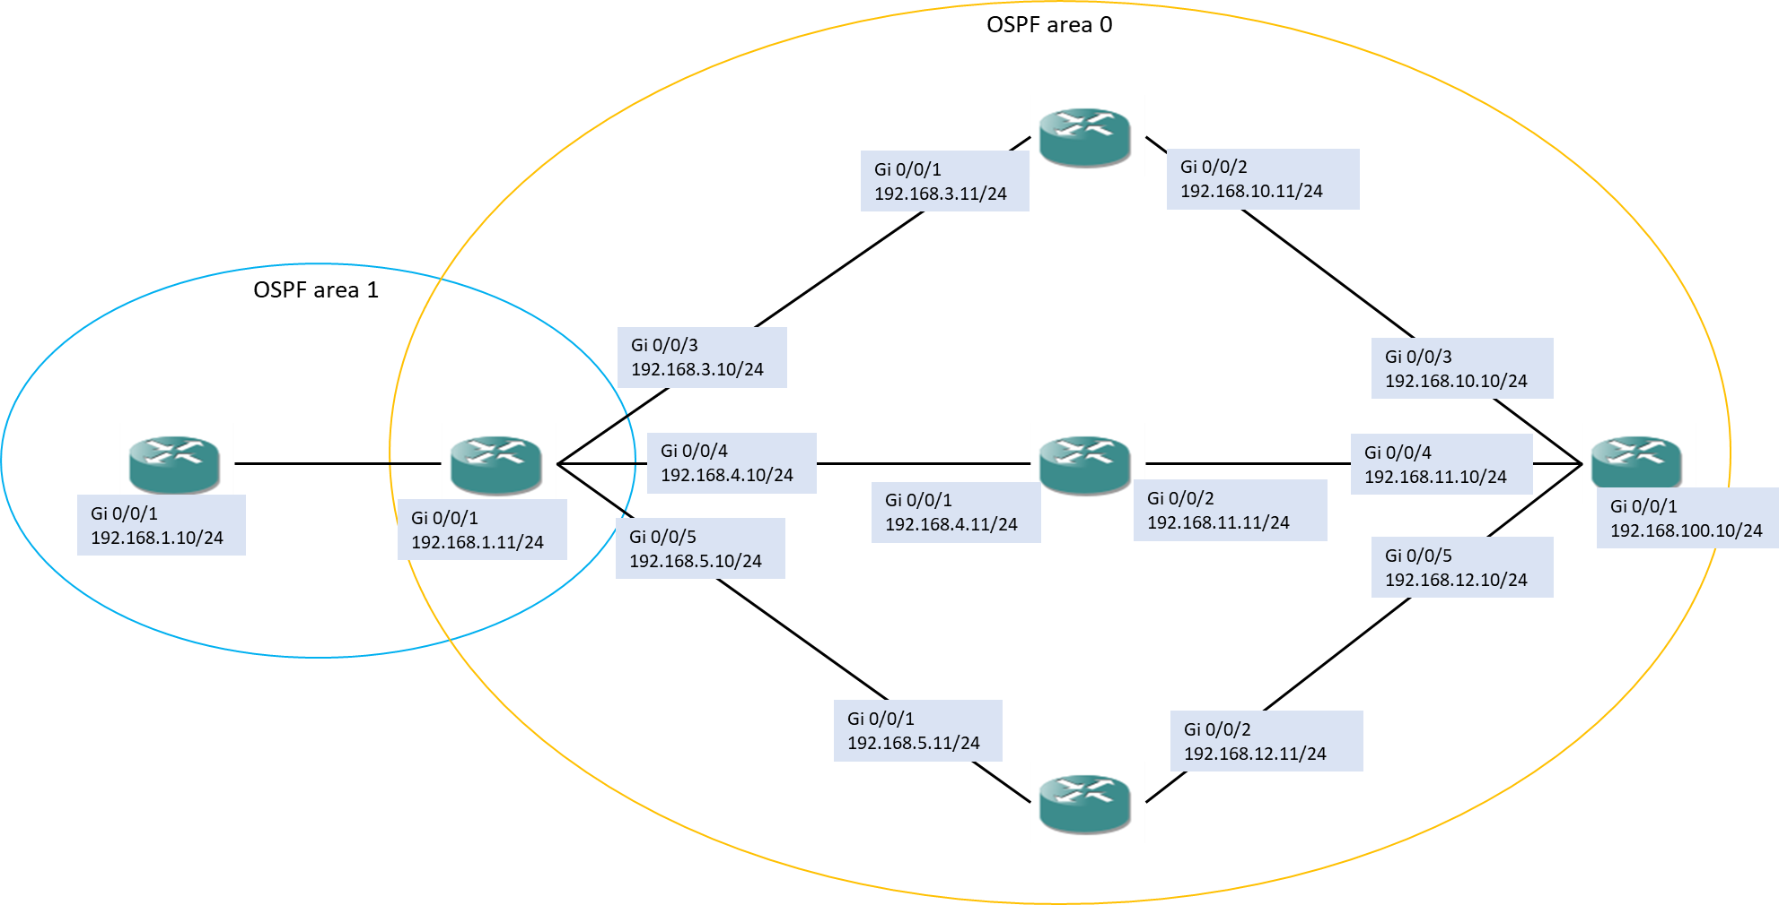

Slide 8
